Slide 1
Budgeting and Forecasting
By
Dr. Dilrukshi Yapa Abeywardhana

Slide 2
Learning outcome
  Define budgeting and explain its role in the management cycle
identify budgeting as one part of the strategic management process
define a budget, its purpose and uses
recognize the importance of forecasting within the budget process and understanding the forecasting methods.
explain the preparation of budgets for planning purposes
prepare the elements of an operating budget and a financial budget to derive the master budget
Explain the interrelationship between economic conditions, industry situation and a firms plans and budgets.

Slide 3
appreciate the motivational and behavioral aspects
of budgeting
explain the preparation of budgets for control purposes
and how performance against budget may be evaluated
identify the potential problems that may be encountered during budget preparation
Define the purpose of pro forma income statement, a pro forma statement of financial position and pro forma cash flow statements and understand the relationship among these statements and budgets.

Slide 4
Outline
Introduction
Budgeting concepts
Forecasting techniques
Budget methodologies
Annual profit plan and supporting schedules
Top level planning and analysis

Slide 5
Introduction
How do some companies become great successes while others struggle?
Why budget?

Slide 6
Budgeting concepts
Planning is the process of mapping out the organization’s future direction to attain desired goals.
Strategy is the organization’s plan to match its strengths with the opportunities in the marketplace to accomplish its desired goals over the short and long term.
Budget is an operational plan and a control tool for n entity that identifies the resources and commitments needed to satisfy the entity’s goals over a period.
The quantitative expression of a proposed plan of action by management for a specified period
Budgeting Is essential part of the continuous planning for an organization in order to accomplish long-term goals

Slide 7
Budgeting is the process of identifying, gathering, summarizing, and communicating financial and nonfinancial information about an organization's future activities
Budgetary control is a management process to help ensure that a budget is achieved by instituting a systematic budget approval process , by coordinating the efforts of all involved parties and operations, and by analyzing variances from the plan

Slide 8
Strategic planning, Budgetary planning and Operational planning
Strategic planning: concerned with preparing long term action plans to attain the organization’s objectives by considering the changes at horizon.
Budgetary planning: is mainly concerned with preparing the short to medium term plan.
Operational planning: concerned with short term day to day planning process

Slide 9
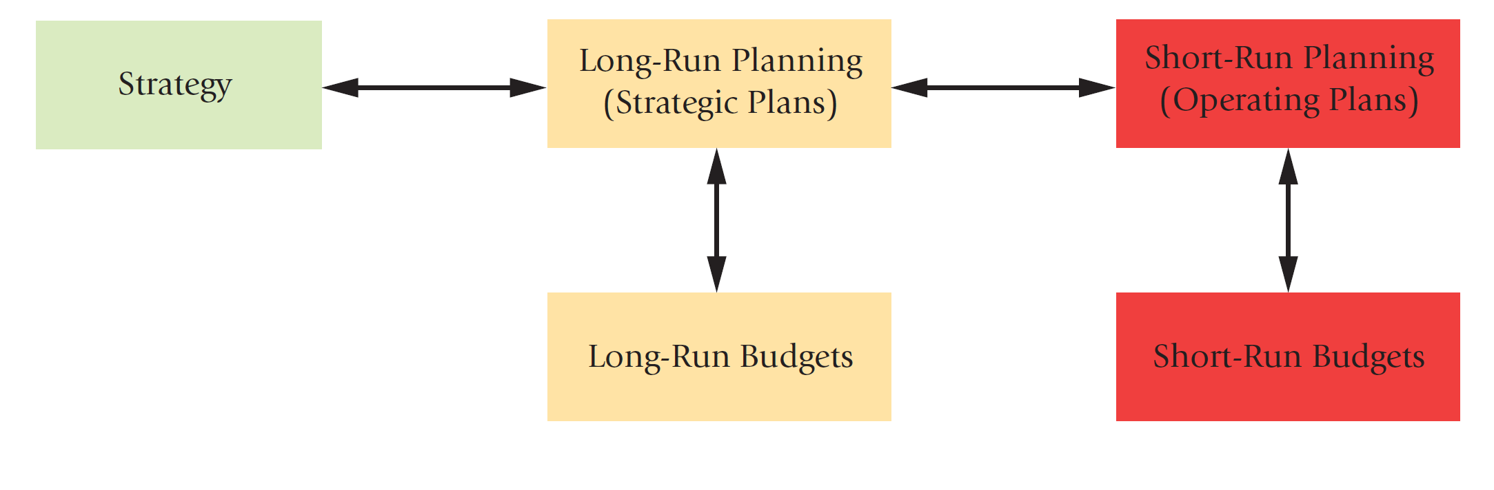
Exhibit 12-1—Strategy, Planning, and Budgets
Exhibit 12-1 shows that strategic plans are expressed through long-run budgets, and operating plans are expressed through short-run budgets. The exhibit shows arrows pointing backward as well as forward. The backward arrows show that budgets can lead to changes in plans and strategies.
Notes:
Exhibit 12-1 shows that strategic plans are expressed through long-run budgets, and operating plans are expressed through short-run budgets. The exhibit shows arrows pointing backward as well as forward. The backward arrows show that budgets can lead to changes in plans and strategies.

Slide 10
Budgeting Cycle
Before the start of the fiscal year, managers at all levels take into account past performance, market feedback, and anticipated future changes to initiate plans for the next period
At the beginning of the year, senior managers give subordinate managers a frame of reference, a set of specific financial or nonfinancial expectations against which they will compare actual results
During the course of the year, management accountants help managers investigate variations from plans, such as an unexpected decline in sales
If necessary, corrective action follows

Slide 11
Budget Cycle

Slide 12
Reasons for Budgeting
Planning
Communication & coordination
Monitoring
Evaluation

Slide 13
Operations and Performance Goals
Strategic decisions provides the basis for planning support
Budgeting facilitates movement toward strategic goals.
Budget plays a role in measuring performance against established goals.
Controllable costs are useful for performance evaluation and budgeting. Non controllable costs like rent, administrative salaries are committed and useful for PE

Slide 14
Successful Budgeting
The budget must be aligned with the corporate strategy
The budget process should be kept separate but should flow from the strategic planning and forecasting process
The budgets should be used to alleviate potential bottlenecks and to allocate resources to those areas that will use the funds most effectively and efficiently.
Should contain technical correct and reasonable numbers and facts
Management must fully endorse the budget
Employees must perceive as a tool of planning, communication and coordinating and motivate them

Slide 15
Budget participants
Top management communicates the strategic direction to budget participants
Participants create the first draft and submit for reviewing and after reviewing every budget item rigorously approval set for the final budget.
Board of Director
Top Management
Budget committee
Middle and Lower Management
Budget coordinator
Process experts

Slide 16
Challenges in Administering Budgets
The budgeting process should involve all levels of management
The budgeting process is time-consuming
To gain the benefits of budgeting, management at all levels of a company should understand and support the budget and all aspects of the management control system
Budgets should not be administered rigidly

Slide 17
Resource Allocation
Allocation of scare resources among competing opportunities is accomplished through implementation of a strategy.

Slide 18
How are short-term goals related to strategic planning?
  Short-term goals define the strategic direction an organization will take over the next year. They are determined to help accomplish the long-term goals that are established during the strategic planning process

Slide 19
Master Budget
Process of preparing a master budget is similar in all three types of organizations(Manufacturing, Retail and Service)
The process differs mainly in the kinds of operating budgets each type of organization prepares
Master budget is a plan on a company’s strategy for controlling its operations for a specified period of time. Master budget expresses management’s operating and financial plans for a specified period, usually a fiscal year. A key point is that master budget are fixed at the expected level of business activity
It includes a set of budgeted financial statements
Under a master budget,
  Operating decisions deal with how to best use the limited resources of an organization
  Financing decisions deal with how to obtain the funds to acquire those resources
Also known as pro forma statements

Slide 20
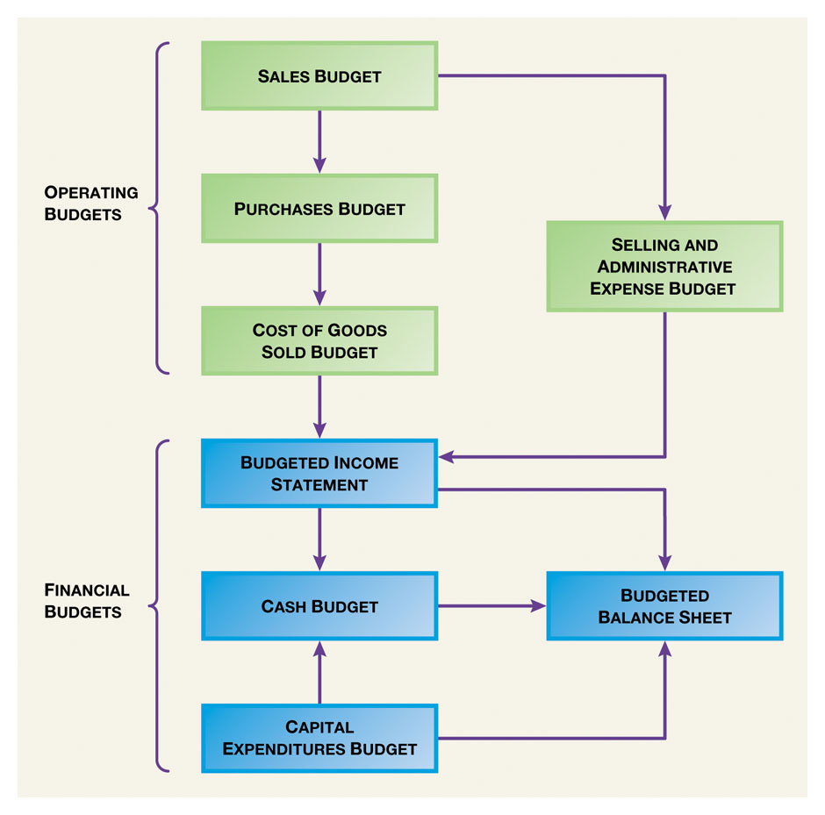
Preparation of a Master Budget for a Retail Organization

Slide 21
Identification of Principle Budget Factor
The principle budget factor is the factor that limits the activities of functional budgets of the organization. In general sales volume is the principle budget factor. So the sales budget must be prepared first.
Alternatively machine hours may be limited for the forthcoming period and therefore machine capacity is the limiting factor. Therefore company should prepare the production budget first.
First need to identify the production capacity of the dept.
Example:

Slide 22
Forecasting Techniques
A vital function of managing any business is planning for the future. Experienced judgment, intuition and awareness of economic conditions may give business leaders a rough idea of what may happen in the future. This experience may be supported by various quantitative methods that can be used to forecast such outcome as next quarter sales volume. In addition degree of uncertainty needs to be incorporated in to the decision making process.
What is Forecasting
Forecasting is a tool used for predicting future demand based on past demand information.

Slide 23
Why is forecasting important?
Demand for products and services is usually uncertain.
Forecasting can be used for…
Strategic planning (long range planning)
Finance and accounting (budgets and cost controls)
Marketing (future sales, new products)
Production and operations

Slide 24
What’s Forecasting All About?
Ahead of the Oscars, an economics professor, at the request of Weekend Journal, processed data about this year's films nominated for best picture through his statistical model and predicted with 97.4% certainty that "Brokeback Mountain" would win. Oops. Last year, the professor tuned his model until it correctly predicted 18 of the previous 20 best-picture awards; then it predicted that "The Aviator" would win; "Million Dollar Baby" won instead.
Sometimes models tuned to prior results don't have great predictive powers.

Slide 25
Some general characteristics of forecasts
Forecasts are always wrong
Forecasts are more accurate for groups or families of items
Forecasts are more accurate for shorter time periods
Every forecast should include an error estimate
Forecasts are no substitute for calculated demand.
Key issues in forecasting
A forecast is only as good as the information included in the forecast (past data)
History is not a perfect predictor of the future (i.e.: there is no such thing as a perfect forecast)
REMEMBER: Forecasting is based on the assumption that the past predicts the future! When forecasting, think carefully whether or not the past is strongly related to what you expect to see in the future…

Slide 26
Types of forecasting methods
Qualitative methods
Quantitative methods
Rely on subjective opinions from one or more experts.
Rely on data and analytical techniques.

Slide 27
Qualitative forecasting methods
Grass Roots: deriving future demand by asking the person closest to the customer.
Market Research: trying to identify customer habits; new product ideas.
Panel Consensus: deriving future estimations from the synergy of a panel of experts in the area.
Delphi Method: similar to the panel consensus but with concealed identities.

Slide 28
Quantitative forecasting methods
Time Series Analysis: models that predict future demand based on past history trends. Aim is to find the pattern in the data set in making forecasts. Involves time as the Independent variable. Four components combine to provide the overall pattern in a time series analysis: trends, cycles, seasonality and irregular variations. Irregular variations occurs due to unanticipated factors. Limitation in TA is that it assumes that past patterns will continue in the future.
Smoothing: is an analytical method that smoothes out the random fluctuations from the irregular component of the time series. Moving Average, weighted moving average and exponential smoothing are 3 smoothing methods.

Slide 29
The moving average model uses the last t periods in order to predict demand in period t+1.
There can be two types of moving average models: simple moving average and weighted moving average
The moving average model assumption is that the most accurate prediction of future demand is a simple (linear) combination of past demand.

Slide 30
Moving Average: Average of most recent data value of a given time period. Example -Jmart has sales of 160 million, 168 million and 176 million in the 3 most recent quarters. Moving Average?
Weighted Moving Average: This method assumes that the most recent data has more power of prediction than data that came before. So more weight is given to the most recent data. Example- assume weight .5 , .3 and .2 assign for the above three quarters starting from the last quarter. Weighted Moving Average ?

Slide 31
Exponential Smoothing: Uses a weighted average of past time series, selecting only one weight- that of the most recent data. The weights for the other data values are automatically computed, getting smaller as the time period moves further into the past.
t is the current time period, Ft+1 is the forecast for the t+1, Yt is the actual value of time , Ft is the forecast for period t and a is the smoothing constant.
Example- a =.2, Y=180 and F=150 Find F+1
Good technique when time series is stable. Smoothing constant should be modified constantly.

Slide 32
Sensitivity Analysis: Decision makers use sensitivity analysis to help decide what changes in a given situation are most likely to produce a particular outcome. This can be used to check the impact of qualitative or subjective state of nature on quantitative outcome.
Regression Analysis: A statistical method used to determine the impact of one/more variables on another variable. RA is used by Mgt Accountants to analyse cost behavior, forecast future evets such as sales levels.

Slide 33
How should we pick our forecasting model?
Data availability
Time horizon for the forecast
Required accuracy
Required Resources

Slide 34
Budget Methodologies
To use its budget as an effective planning and management tool, a company must choose and budget methodology that supports and reinforces its management approach.
Depending on type of business, organizational structure, complexity of operations and management philosophy a company choose different approaches in formulating its master budget.
Project Budgeting: Used for creating a budget for specific projects rather than for an entire company
Activity based budgeting: focuses on classifying costs based on activities rather than based on departments or products.
Incremental budgeting: starts with the prior year budget and produces increments into the future based upon the prior year’s results and coming year’s expectations.(Opposite of the zero based budget.)

Slide 35
Zero based budgeting: Starts each new budgeting cycle from scratch as though the budgets are prepared for the first time.
Continuous budgeting: Allows the budget to be continually updated by removing information for the period just ended (April this year) and adding estimated data for the same period next year.(April next year)
Flexible budgeting: serves as a control mechanism that evaluates the performance of managers by comparing actual revenue and expenses to the budgeted amount for the actual activities. Most Business use FB

